Slide 1
Data Science Job Postings Analysis
University of Chicago
Data Mining Principles – Final Presentation
March 2021

Slide 2
Contents
Executive Summary
3
Our Work Approach
5
14
Key Takeaways

Slide 3






Executive Summary > Introduction
Our team consisted of interesting individuals with diverse cultures, across different continents, and different time zones …
Executive Summary
Our Work Approach
Key Takeaways
Questions
United States
of America
Name - Gina Champion
Industry – Medical Device Market Research
Experience – 6yrs
Email – gachampion@uchicago.edu
China
Name - Stella Cao
Industry – Tech, TBD
Experience – 0
Email – zijcao@uchicago.edu
Nigeria
Colombia
Name - Ignas Grabauskas
Industry – Investment Management
Experience – 6yrs
Email – ignasg@uchicago.edu
Name - Kaihao Fan
Industry – Medical Device
Experience – 1yr
Email – kaihaofan@uchicago.edu
Name - Nicolas Yanez
Industry – Healthcare
Experience – 4yrs
Email – nyanez@uchicago.edu
Name - Oluwafemi Fabiyi
Industry – Big4 Consulting
Experience – 11yrs
Email – fabiyio@uchicago.edu

Slide 4



Executive Summary > Problem Statement & Project Objectives
Executive Summary
Data availability and its demonstrable value have created demand amongst employers for individuals with the necessary skills and experience. Our objective is to utilize the job descriptions of job postings for three commonly sought-after positions in data analytics in order to extract insights in their similarities and differences.
Our Work Approach
Key Takeaways
Questions
1
Overlapping
Job Descriptions
2
Review existing job
description
3
Gain insight into the
nuances of the
requirement for these
roles

Slide 5






Our Work Approach > Overall Approach
Executive Summary
Our Work Approach
Plan
Design
Build
Implement
Overall Approach
Project Organization
Data Collection and Design Consideration
Core Analytics Task Execution
Make Actionable
Methodology
Key Takeaways
Questions
Team Members Selection
Data Collection
Environment Installation
Model
Assessment & Selection
Project Topic Research and Selection
High level
Data Review
Data
Cleaning
Quality assurance testing
Project Brief Development
Design Considerations
Feature
Engineering
Project
Presentation
Exploratory Data Analysis
Model
Development
Start
2 Weeks
2 Weeks
3 Weeks
2 Weeks
End
Completed
Completed
Completed
Where we are !
Notes:
Our team structured the delivery of this project across the following 4 project phases with the core Analytics task spread across the design and build phases

Slide 6





Our Work Approach > Data Cleaning
Executive Summary
Our Work Approach
1
Data Scientist
3,909 by 17
1
Data Scientist
Overall Approach
Data Analyst
2,253 by 16
Methodology
2
3. Load
2
Data Analyst
1. Extract
Key Takeaways
3
Business Analyst
4,092 by 17
3
Business Analyst
Questions
Consolidated
10,254 by 15
Source
2. Transformation
Destination
https://www.kaggle.com/andrewmvd
1 - Addressing Extra Columns
Each data set had some non-descript columns that needed investigating.
For the Business Analyst dataset, the non-descript columns were the result of a subset of rows being shifted.
3 - Imputing Founded Year
KDE was used to impute the missing values for the Founded Year column
Grid search was applied to find the optimal bandwidth
A sample was drawn from the fitted KDE to fill missing values
2 - Combining Datasets
Before combining datasets, a target column in each dataset was created to indicate the job type: business analyst, data analyst, or data scientist
After combining datasets, subsequent cleaning was done
4 - Imputing Rating
KDE was used to impute the missing values of the Rating column
Grid search was applied to find optimal bandwidth
A sample was drawn from the fitted KDE to fill missing values
5 - Miscellaneous
Cleaned up Job Description by replacing meta characters
Cleaned up Company Name column by removing embedded ratings
Dropped columns that weren’t needed for analysis e.g., Revenue (categorical) which had mostly missing values

Slide 7
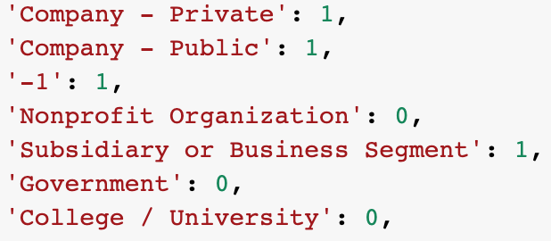
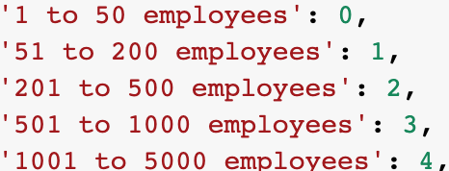
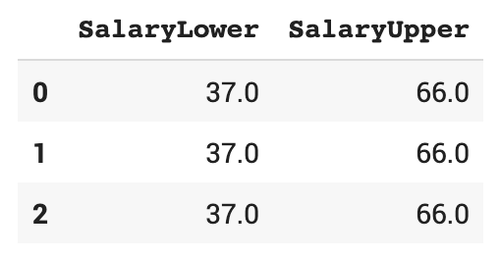
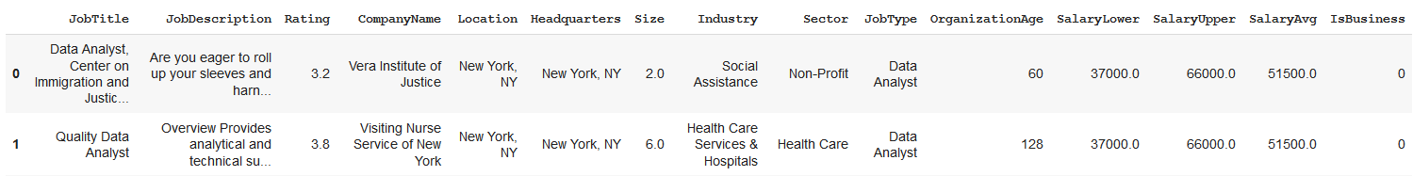
Our Work Approach > Feature Engineering
Executive Summary
02 - Company & Size columns
Our Work Approach
03 – Text Data Processing
Company Ownership and Size columns were both string type
New features were created of integer type to reflect the categorical nature of the strings
Job Description was taken through various transformations to create a feature space suitable for NLP work
Overall Approach
Methodology
Key Takeaways
01 - Salary Information
Questions
Was originally a text column that contained hourly and yearly rates. Rates were extracted to create numerical columns
02
03
04 – Final Dataset
Copies of cleaned data were saved and read to ensure availability for re-use/backup
01
04

Slide 8
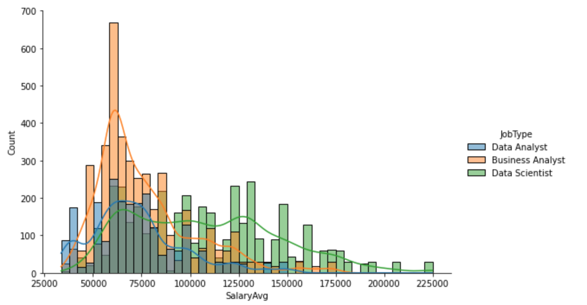
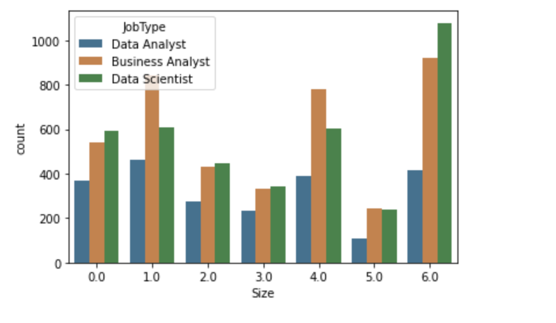
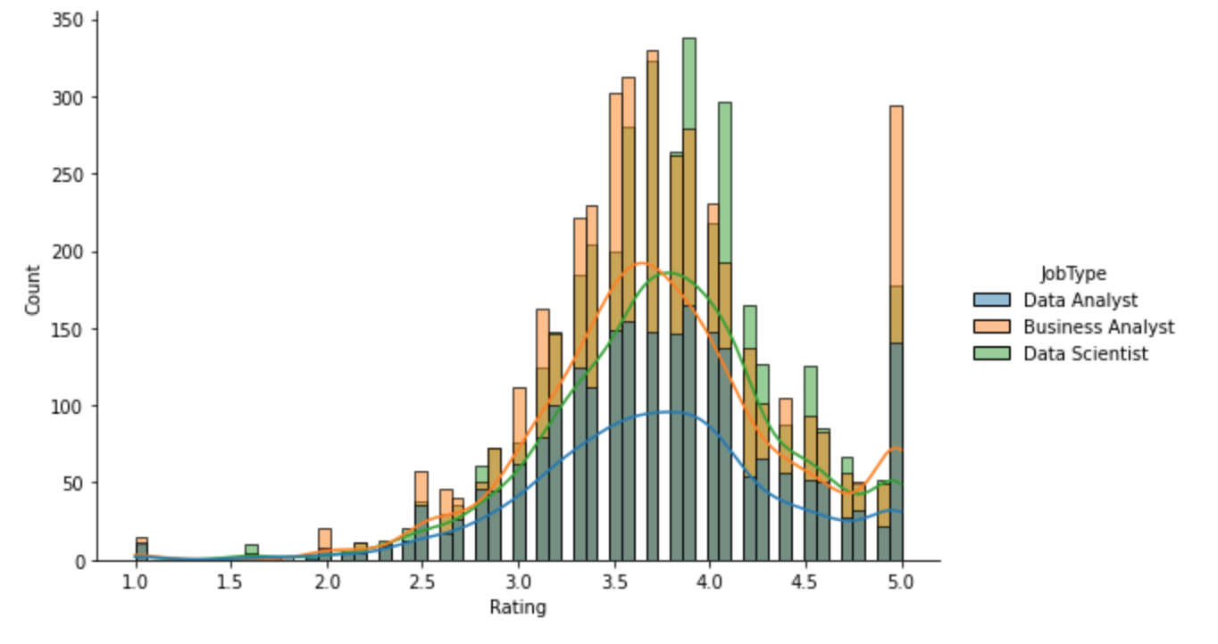
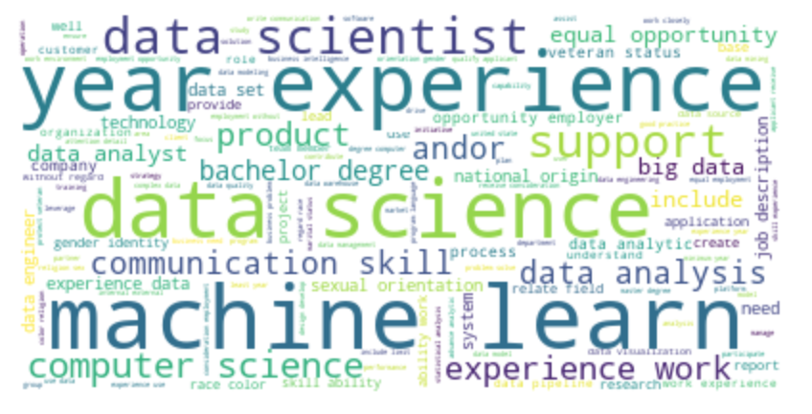
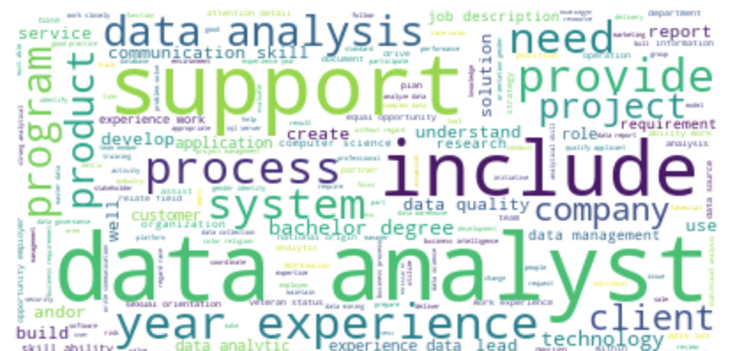
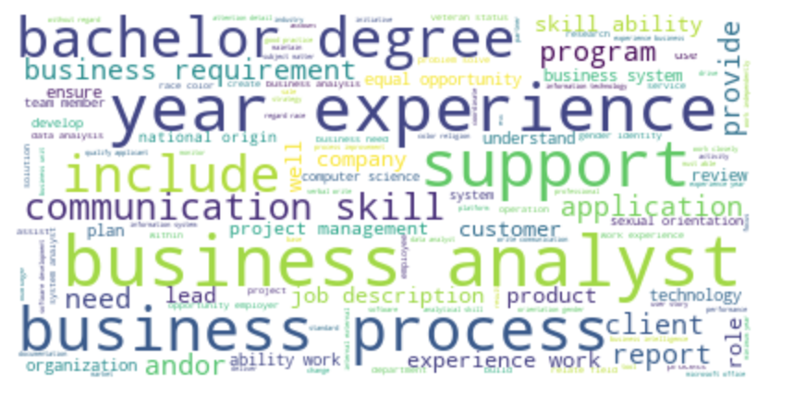
Our Work Approach > Exploratory Data Analysis (1 of 2)
Executive Summary
Salary Distribution
Company Size Distribution
Rating Distribution
Our Work Approach
Overall Approach
Methodology
Key Takeaways
Questions
Data Scientist
Data Analyst
Business Analyst

Slide 9
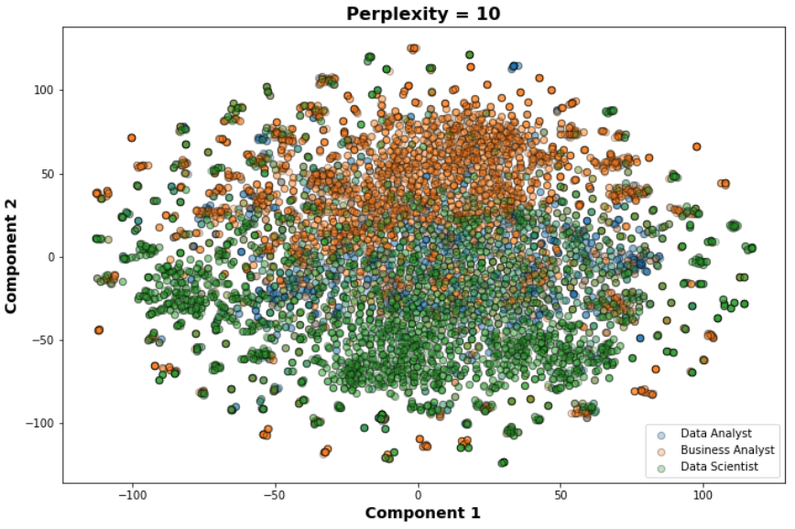
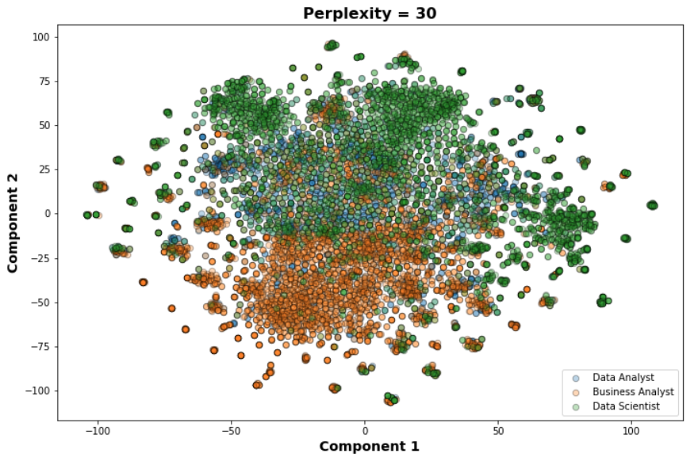
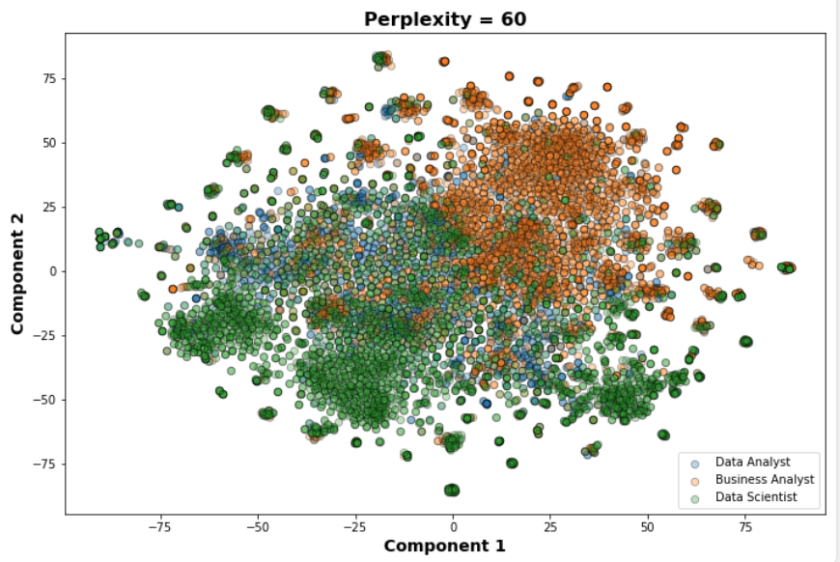
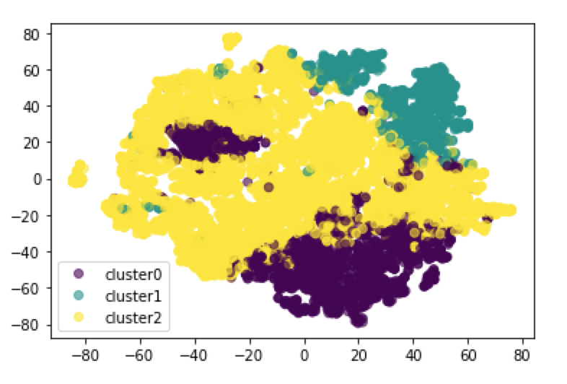
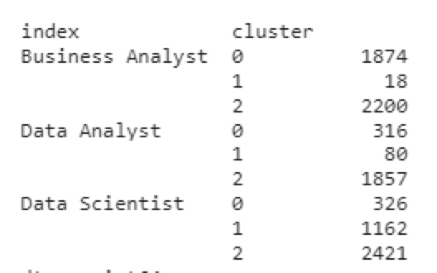
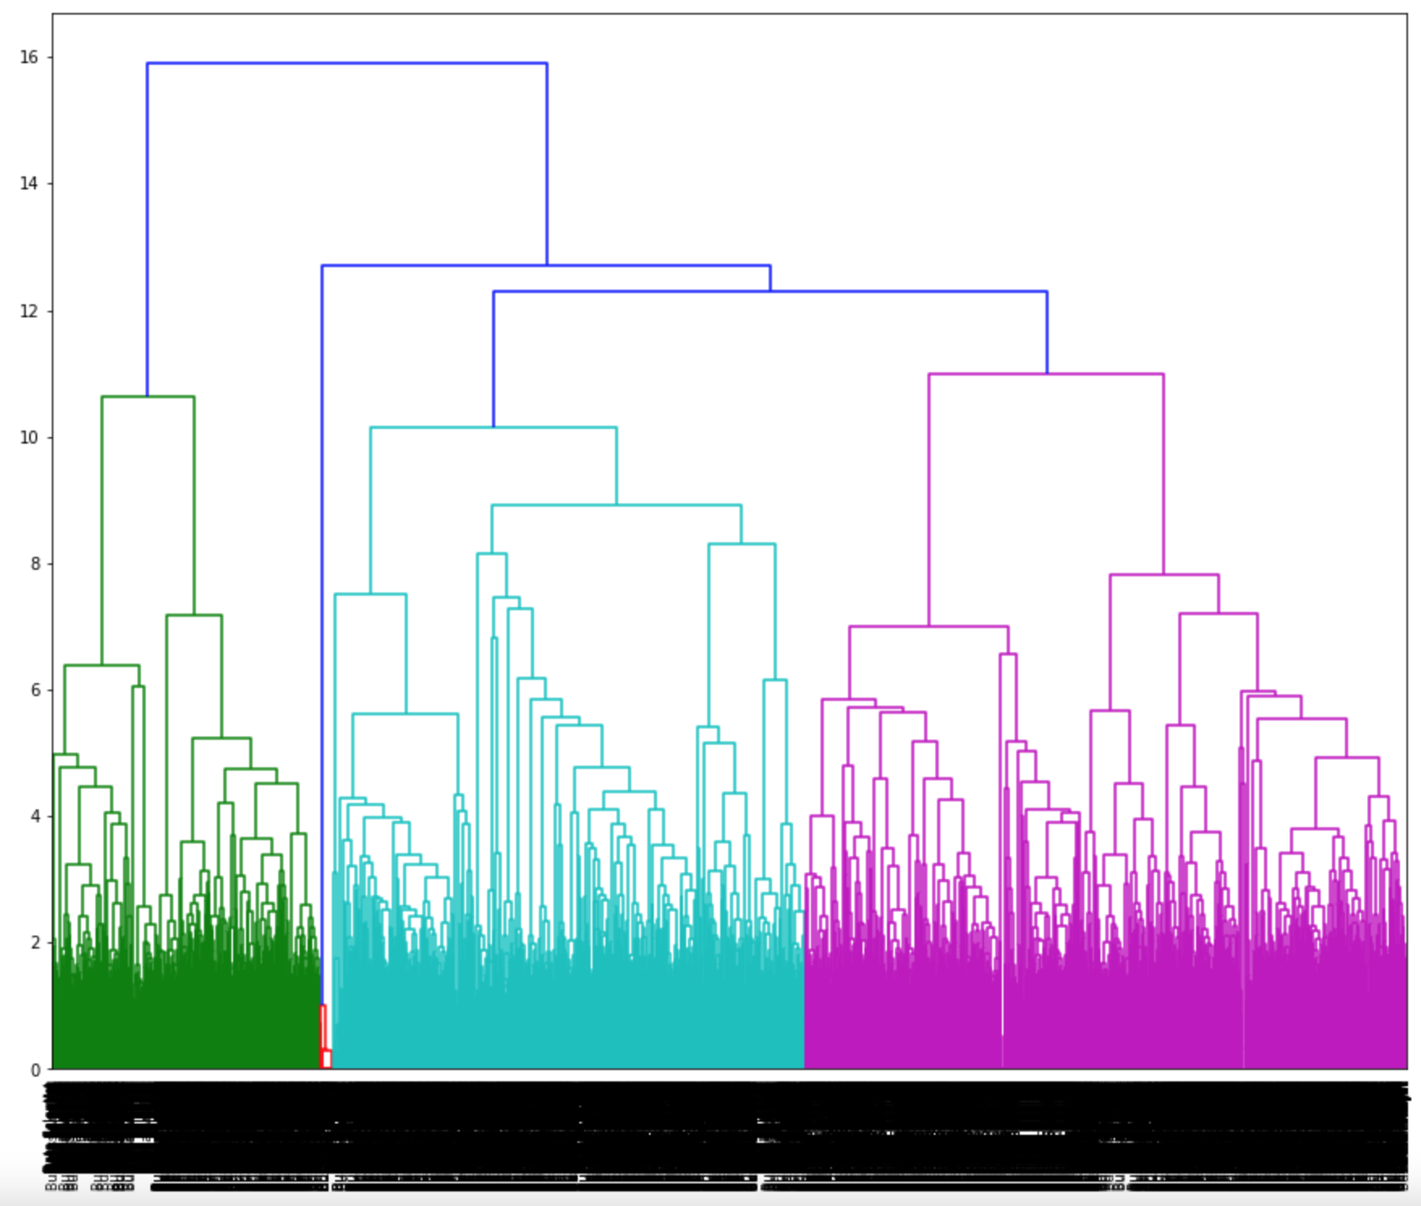
Our Work Approach > Exploratory Data Analysis (2 of 2)
Executive Summary
Job Description – t-SNE
Our Work Approach
Overall Approach
Methodology
Key Takeaways
Questions
Hierarchical Clustering + TFIDF
K-Means + NMF
Actual vs K-Means Label Comparison
Notes:
Given our analysis would rely heavily on the job description, we tried to understand if the feature space created by job description had any structure

Slide 10
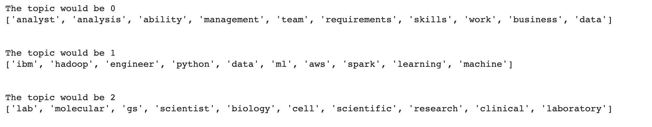
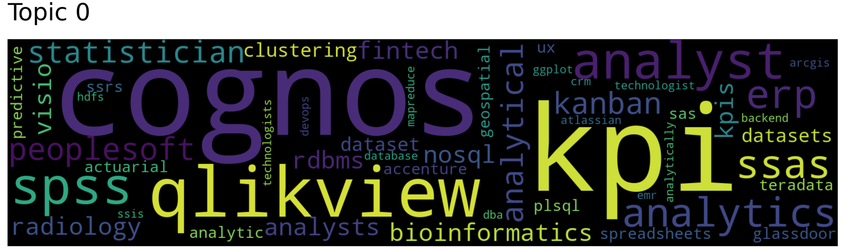
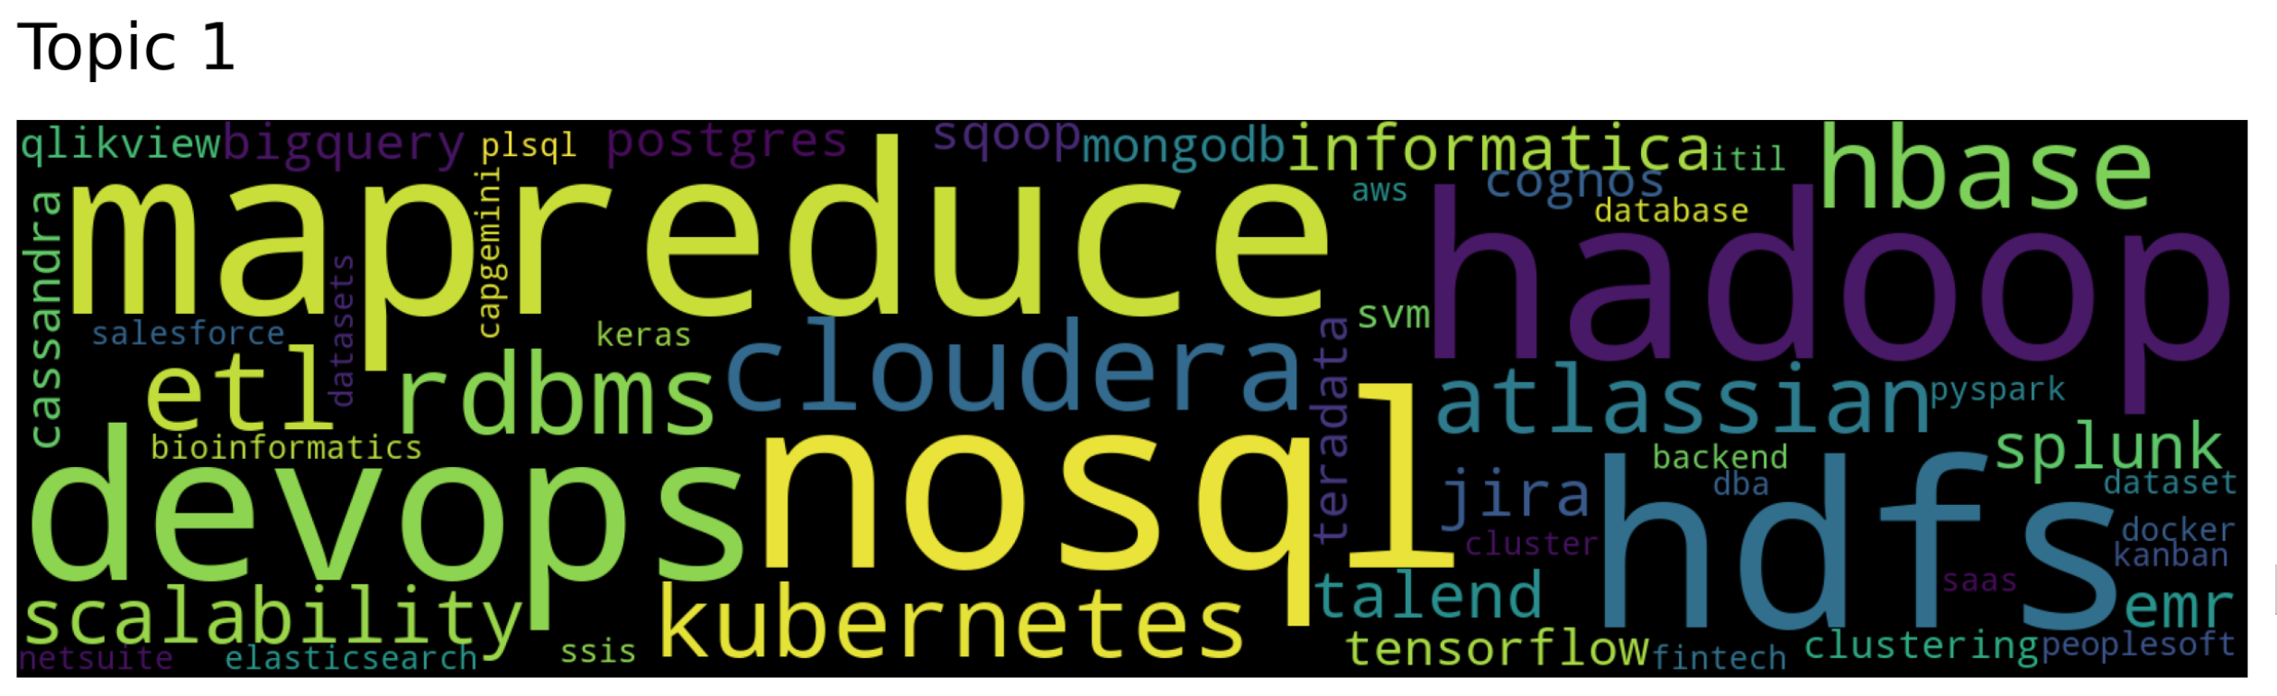
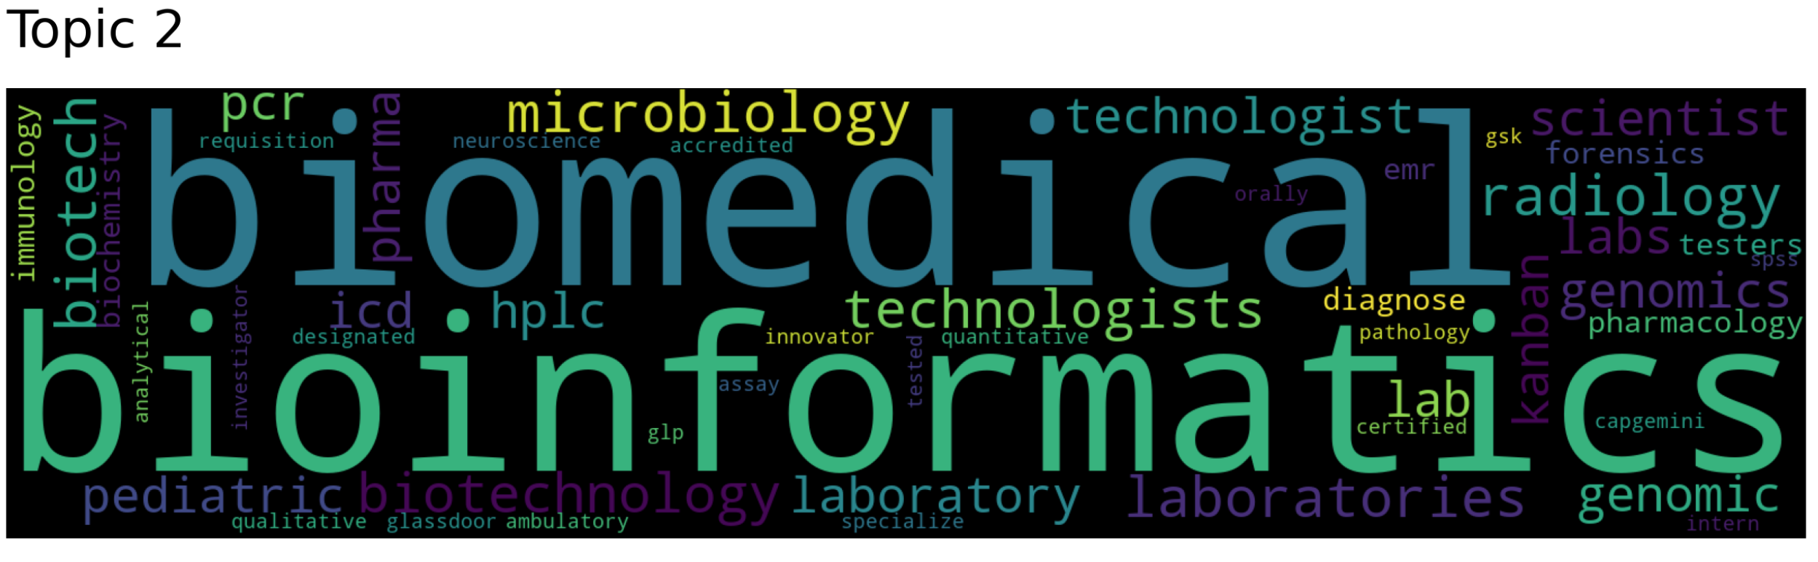
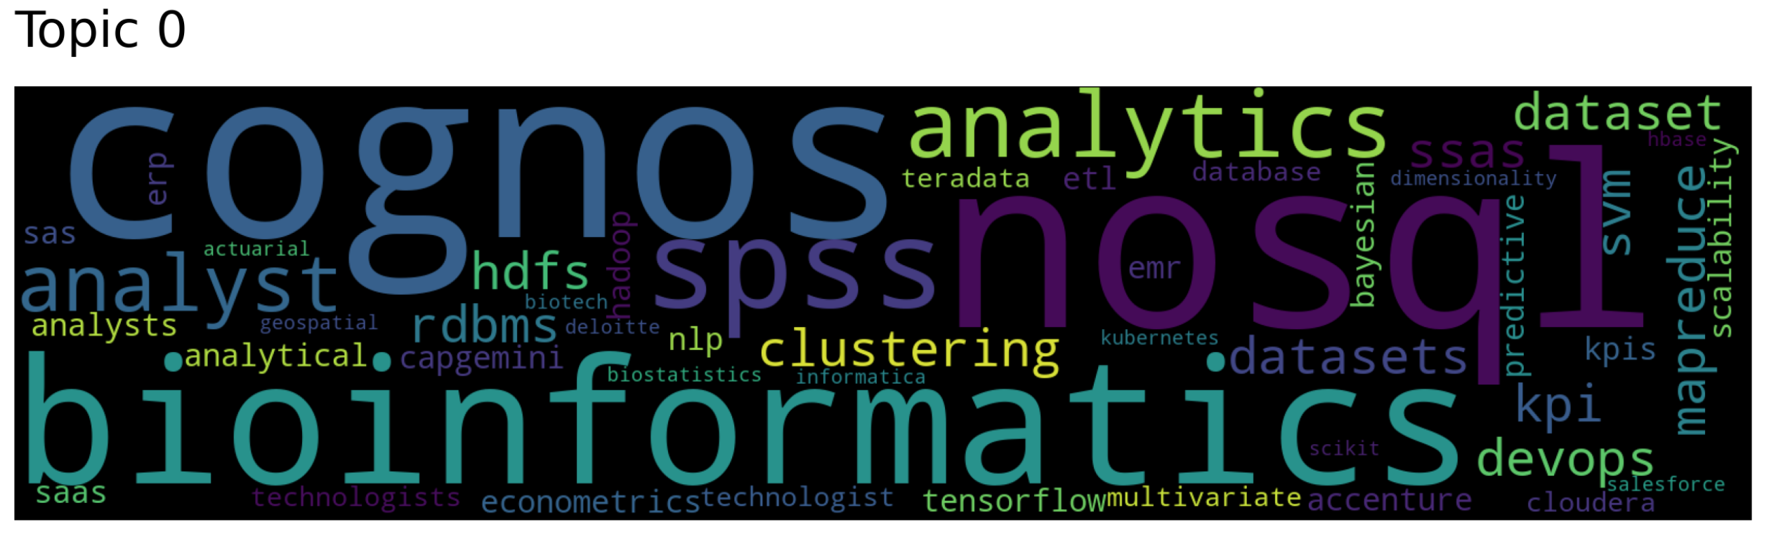
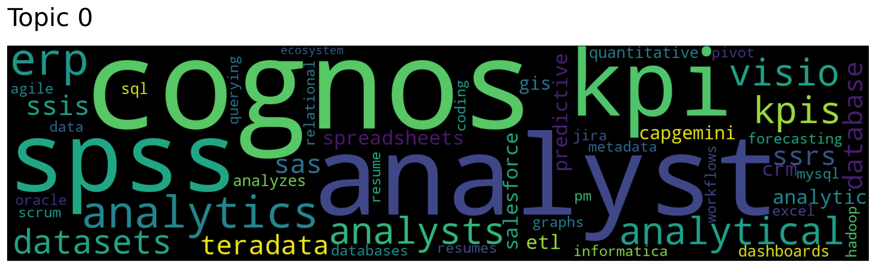
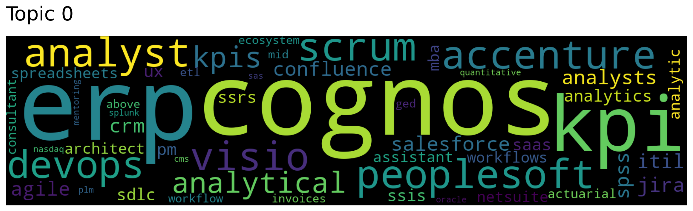
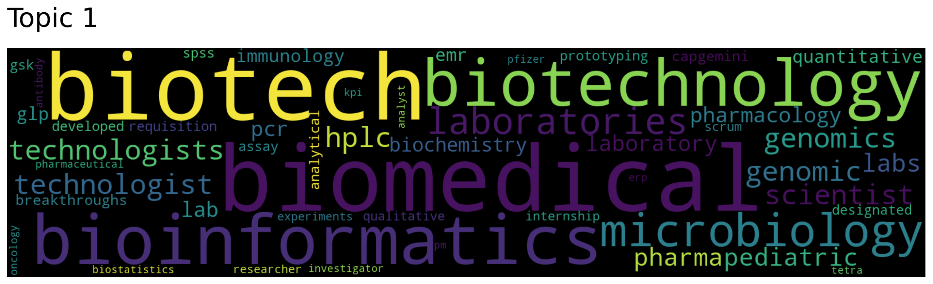
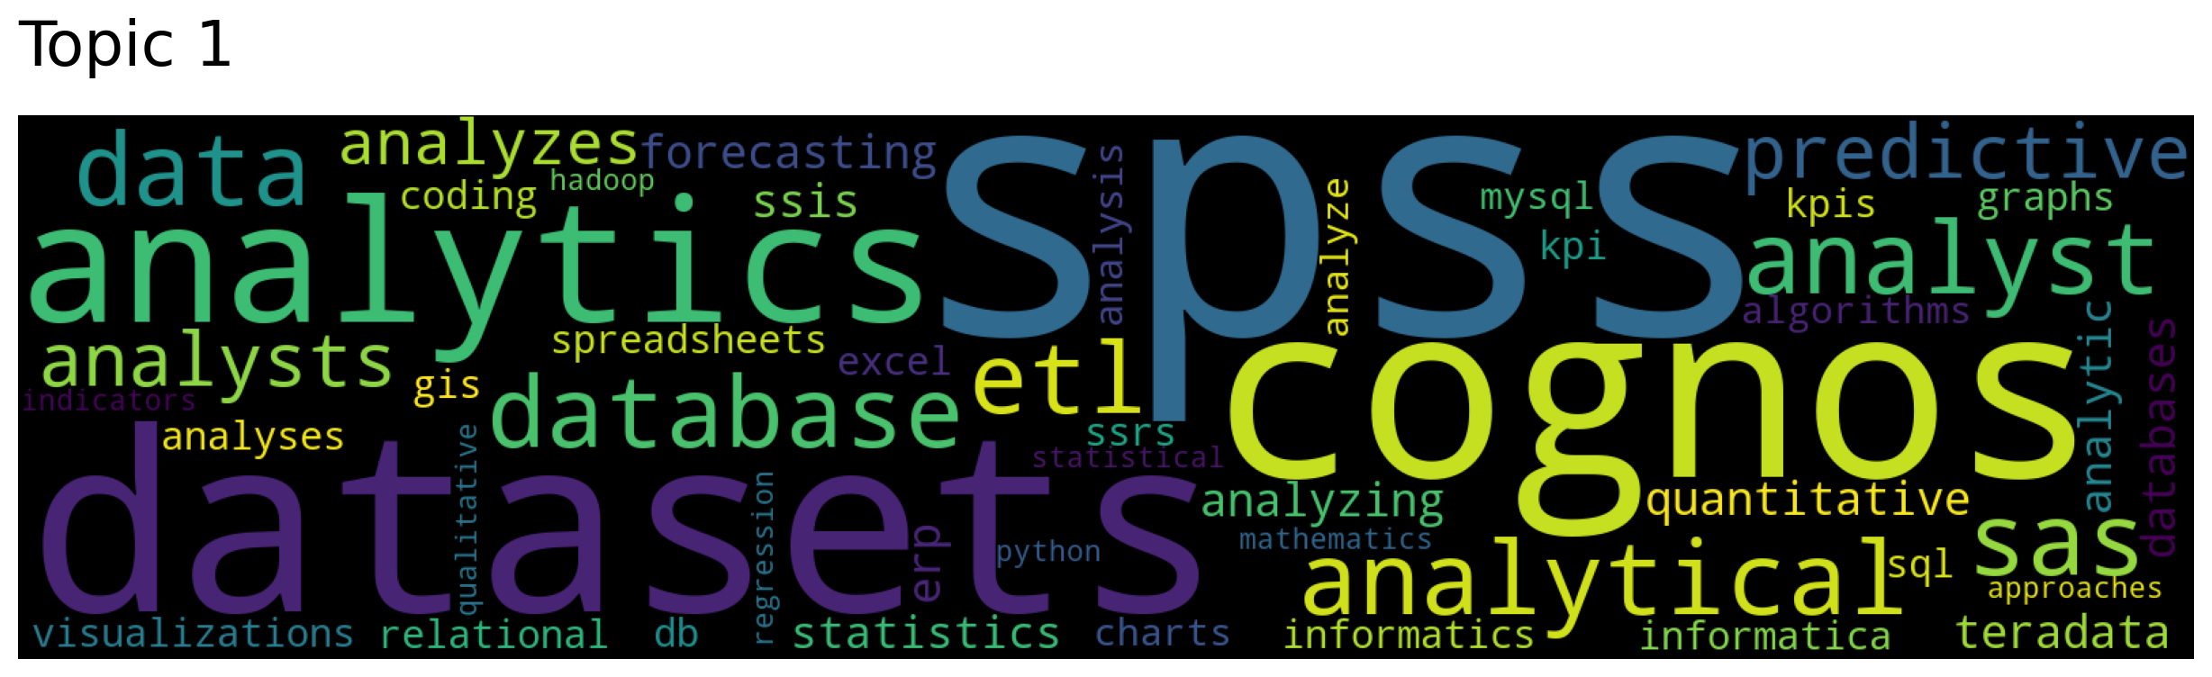
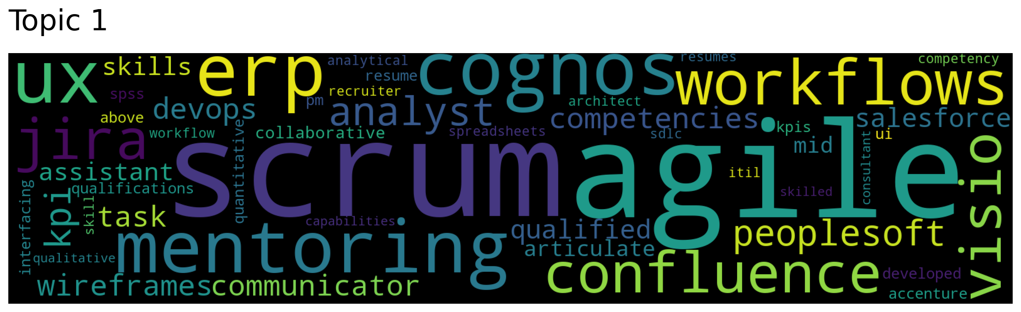
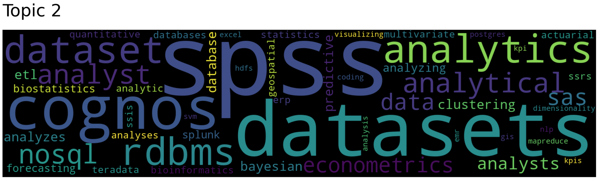
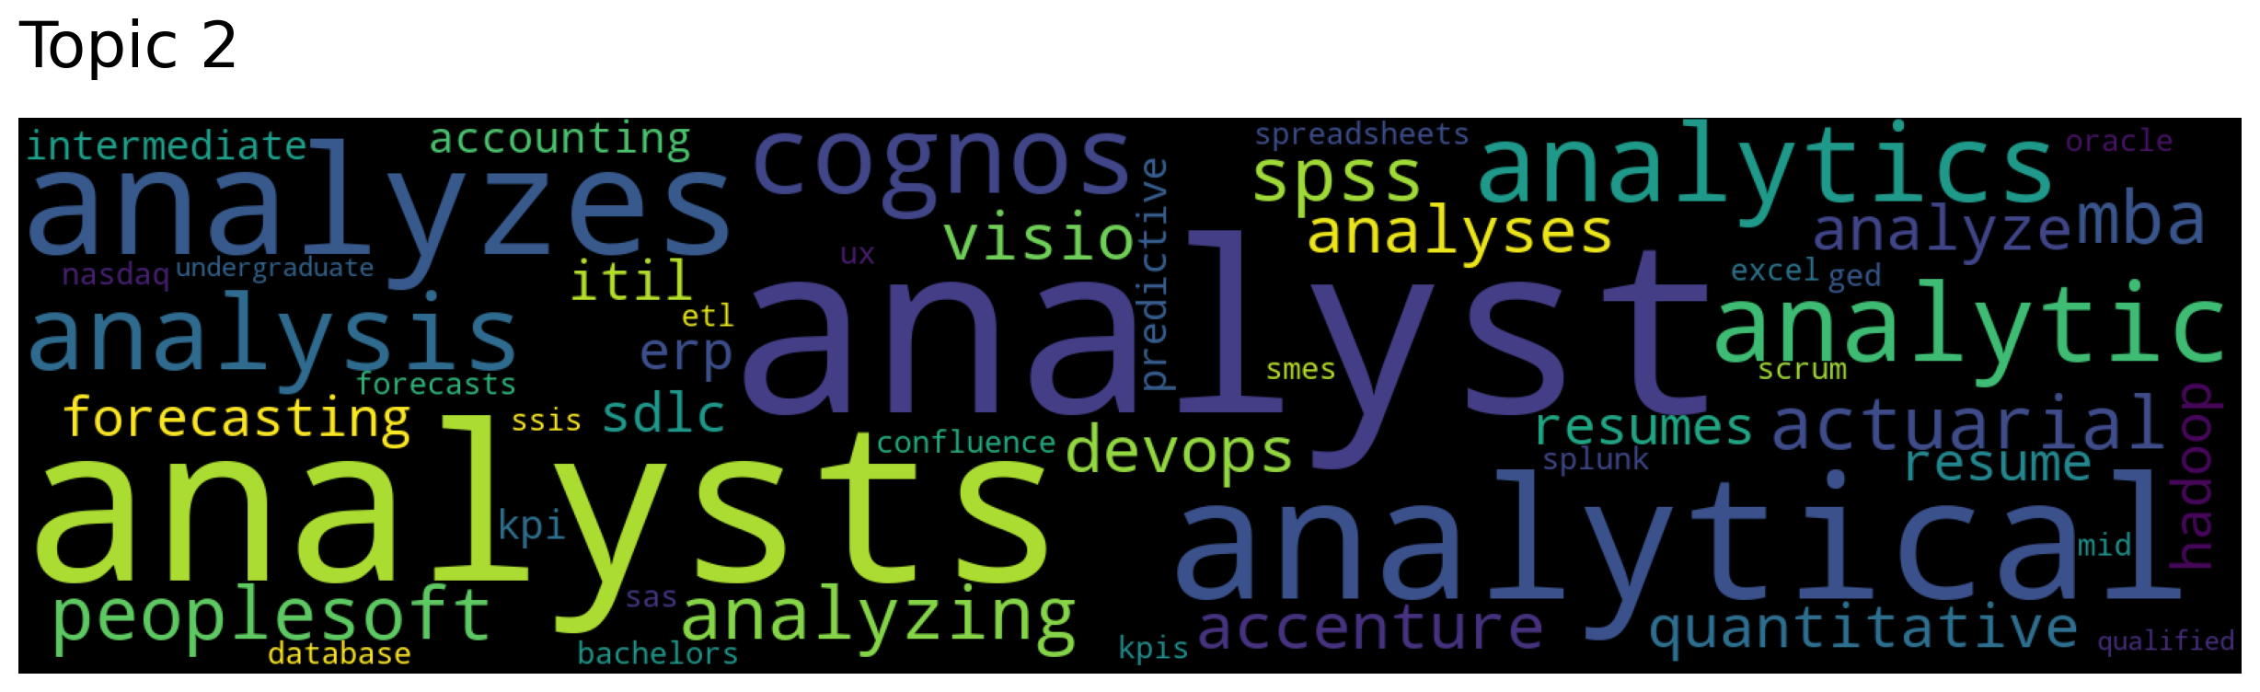
Our Work Approach > Modeling (1 of 4)
Executive Summary
Top2Vec – Overall Dataset
Latent Dirichlet Allocation (LDA)
Our Work Approach
Overall Approach
Methodology
Key Takeaways
Questions
Data Scientist
Data Analyst
Business Analyst

Slide 11
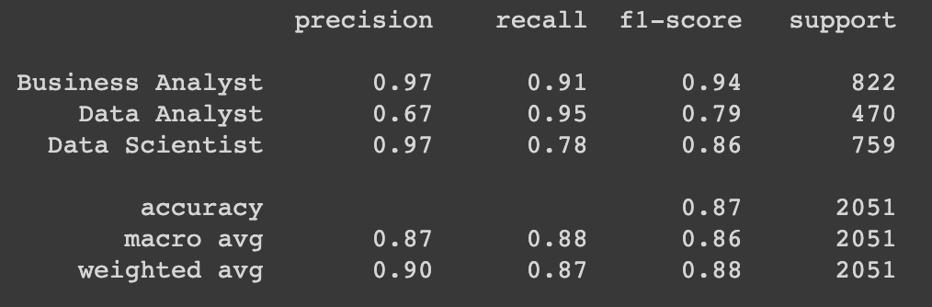
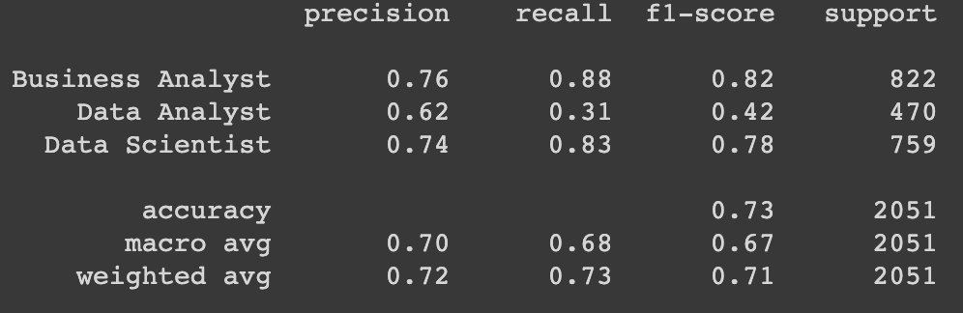
Our Work Approach > Modeling (2 of 4)
Executive Summary
Job Title SVM (Stopwords Removed + stemmed)
Our Work Approach
Job Title Classification Accuracy
 | Naïve Bayes | SVM
No preprocessing | 0.822 | 0.8639
Stopwords removed | 0.8235 | 0.8644
Stopwords removed + stemming | 0.8203 | 0.8634
Job Description Classification Accuracy
No preprocessing | 0.7172 | 0.7252
Stopwords removed | 0.7248 | 0.7471
Stopwords removed + stemming | 0.733 | 0.7503
Parameters (after Grid Search)
Loss | Hinge
Penalty | 12
Alpha | 0.001
Random State | 1
Ngram | (1, 2)
Overall Approach
Methodology
Key Takeaways
Questions
Job Description SVM (Stopwords Removed + stemmed)
Parameters (after Grid Search)
Loss | Hinge
Penalty | 12
Alpha | 0.001
Random State | 1
Ngram | (1, 2)

Slide 12
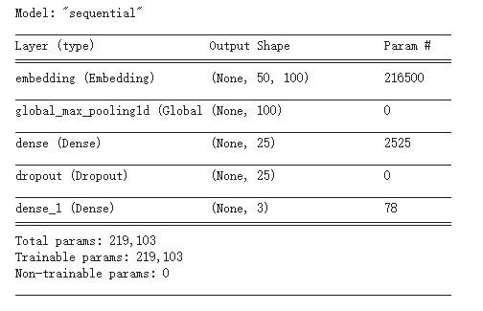
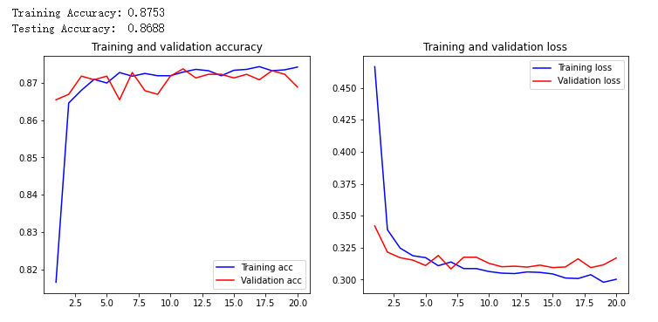
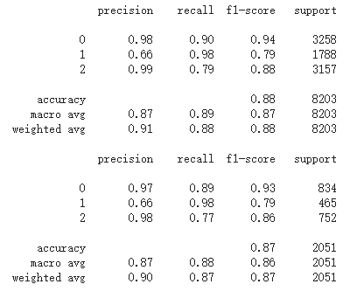
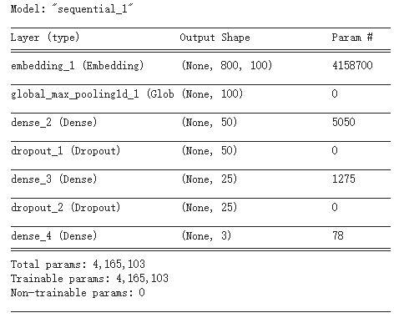
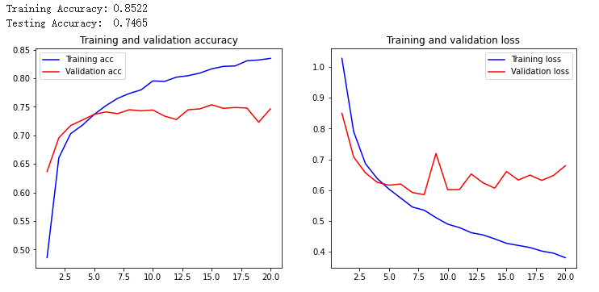
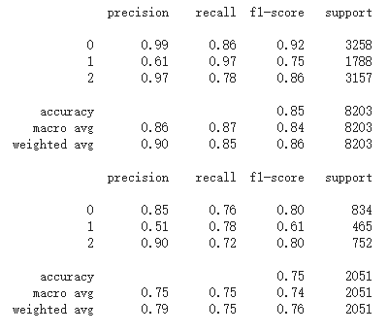
Our Work Approach > Modeling (3 of 4)
Executive Summary
Job Title - Neural Network
Our Work Approach
Overall Approach
Methodology
Key Takeaways
Questions
Job Description - Neural Network

Slide 13
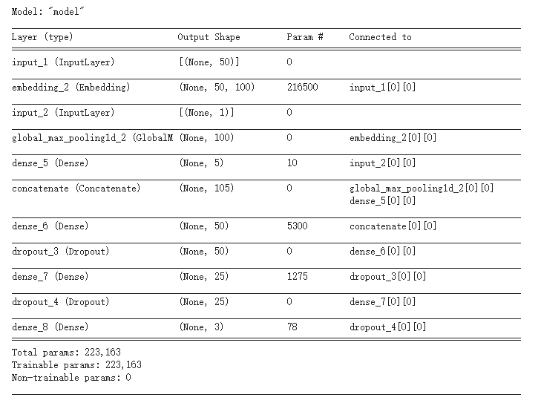
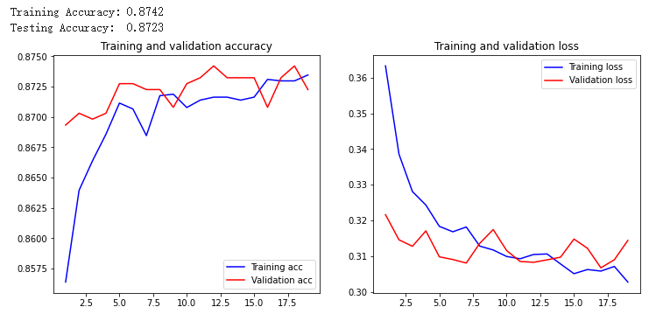
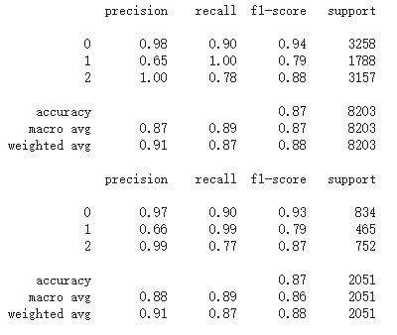
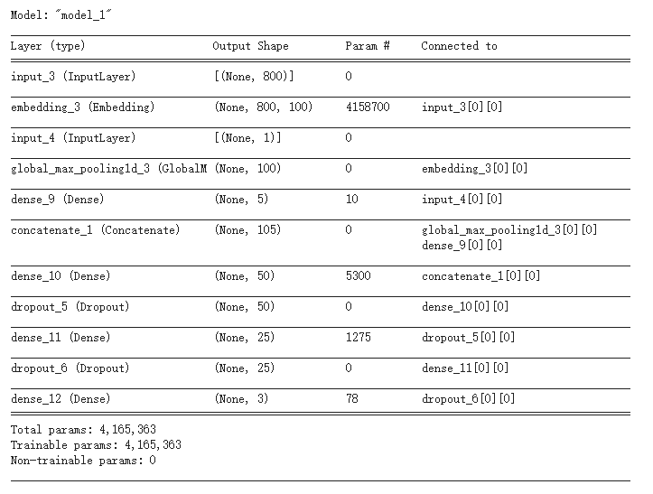
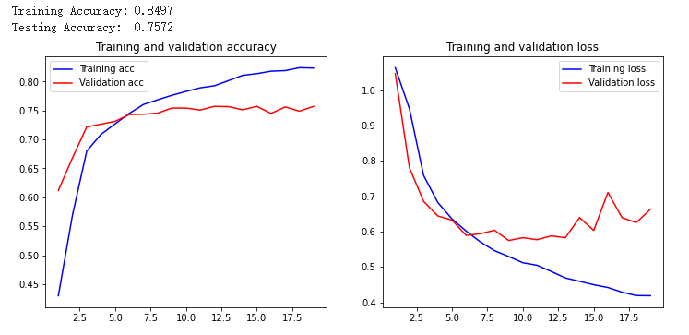
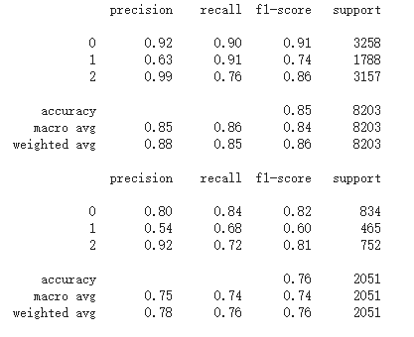
Our Work Approach > Modeling (4 of 4)
Executive Summary
Job Title + Salary - Neural Network
Our Work Approach
Overall Approach
Methodology
Key Takeaways
Questions
Job Description + Salary - Neural Network

Slide 14
Key Takeaways > Results, Conclusions, Recommendations
Executive Summary
Conclusion
Other Features
Salary seemed somewhat promising based on EDA but showed little improvement for modeling
Our Work Approach
Model Performance
NB, SVM, and NN both arrived at similar accuracy (SVM outperformed NB)
Ambiguity
Difficult to differentiate between various job descriptions
Key Takeaways
Questions
Challenges
Orchestration
Aggregating individual development into final notebook (each person doing their work in a decentralized fashion)
Working on final notebook in parallel
Modeling
Steep learning curve given inexperience in NLP
Future Improvements
Job Title
Better validation that the datasets include only the jobs they are supposed to
Other NLP Techniques
Choose techniques that suit the task
Model Selection
Given the EDA, utilize other models

Slide 15
Executive Summary
Our Work Approach
Key Takeaways
Questions
Questions

